Slide 1
Biodiversity Investigation
Bowen Ya

Slide 2
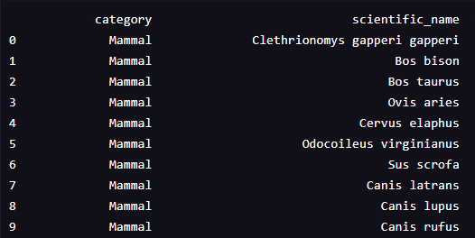
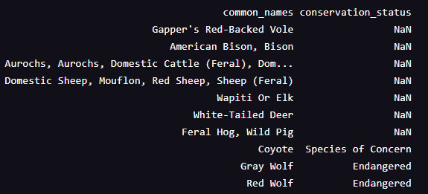
Section I Endangered Species Study Data provided: species_info.csv
lists all the species that can be found in the National Parks, and specifically indicates the endangerment level of these species
Sample data:

Slide 3
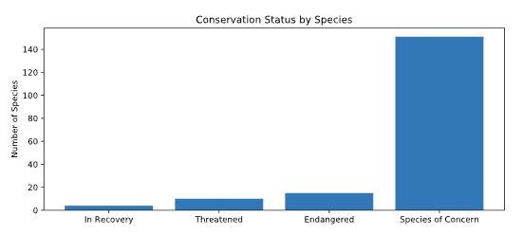
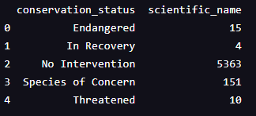
Data Interpretation
Mammal
Bird
Reptile
Amphibian
Fish
5 animal categories
5541 different species 180 among them need attention
2 plant categories
Vascular Plant
Nonvascular Plant

Slide 4
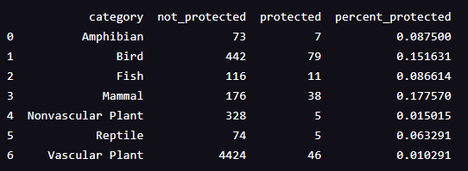
Are certain types of species more likely to be endangered?
We grouped each category by the conservation status of the species, and ran chi-squared tests to different pairs of categories.
Our null hypothesis: The difference between the protection ratios of two categories are due to chance

Slide 5
Chi-Squared Test Results
The p-value of test between Mammal and Bird is which means we fail to reject the null, and there are no significant difference between these two categories.
However, the p-value of test between Reptile and Mammal is and we are confident to reject the null hypothesis. Mammals are more likely to be endangered than reptiles!

Slide 6
Recommendation for conservationists:
After running more tests between different pairs of categories of species, we got the conclusion that categories that would significantly more easily be endangered are (in descending order):
Mammal
Bird
Amphibian
Pay closer attention on these categories would be a wise choice!

Slide 7
Section II A Study on Foot and Mouth Disease Reduction Effort
Expected to see a 5% Reduction of foot and mouth disease in a certain National Park
In order to do that with confidence, we need a valid sample size

Slide 8
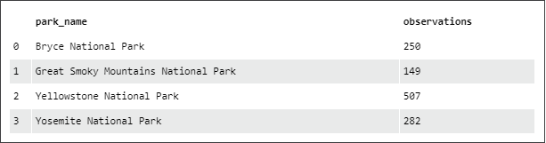
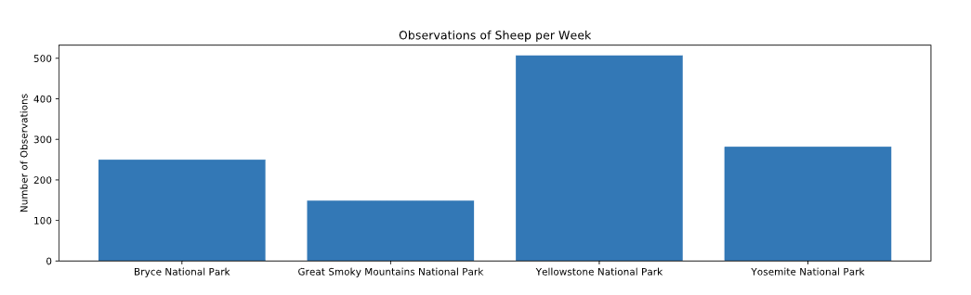
Observations of Sheep in National Parks

Slide 9
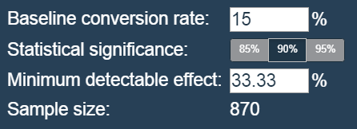
With our given rate, the sample size calculator shows that a sample size of 870 would give us 90% confidence of our 5% foot and mouth reduction detection.

